Slide 1

TAREFA DATASET GRUPO
Predicting Airbnb experiences
Grupo 50

Slide 2
Data Source
Kaggle: Airbnb prices in European Cities
Zenodo: Determinants of Airbnb prices in European cities: A spatial econometrics approach

Slide 3
10
2
20
x
=
Cities
Set Types
Csv files
Data Sets
Amsterdam, Athens, Barcelona, Berlin, Budapest, Lisbon, London, Paris, Rome, Vienna
Weekend, Weekdays
An accumulated approximate 54500 rows of data
Dataset Sources:
https://www.kaggle.com/datasets/thedevastator/airbnb-prices-in-european-cities
https://zenodo.org/records/4446043#.ZEV8d-zMI-R

Slide 4
Data Significance
The datasets contained the following columns:
realSum (numerical, continuous): the full price of accommodation for two people and two nights in EUR
room_type (categorical): the type of room being offered (e.g. private, shared, etc.)
room_shared (boolean): Whether the room is shared or not.
room_private (boolean): Whether the room is private or not.
person_capacity (numerical, discrete): the maximum number of guests
host_is_superhost (boolean): dummy variable for superhost status
multi (boolean): dummy variable if the listing belongs to hosts with 2-4 offers
biz (boolean): dummy variable if the listing belongs to hosts with more than 4 offers
cleanliness_rating (ordinal): The cleanliness rating of the listing.
guest_satisfaction_overall (ordinal): The overall guest satisfaction rating of the listing.
bedrooms (numeric, discrete): number of bedrooms (0 for studios)
dist (numeric, continuous): distance from city centre in km
metro_dist (numeric, continuous): distance from nearest metro station in km
attr_index (numeric, continuous): attraction index of the listing location
attr_index_norm (numeric, continuous): normalised attraction index (0-100)
rest_index (numeric, continuous): restaurant index of the listing location
rest_index_norm (numeric, continuous): normalised restaurant index (0-100)
lng (numeric, continuous): longitude of the listing location
lat (numeric, continuous): latitude of the listing location

Slide 5
Data processing
Join data, process null values, determine imprecissions, maintain consistency

Slide 6
Data processing
First questions
For data of the same city, is all data coherent?
Across sets of weekend data and weekday data, are the values of the column dist and metro_dist the same for airbnbs with the same latitude and longitude?
Is there missing data in the datasets?
Do we have null values in any column?
How to join all 20 csv files together?
Since we have two types of data sets for 10 cities, how do we make one single dataframe with all information?

Slide 7
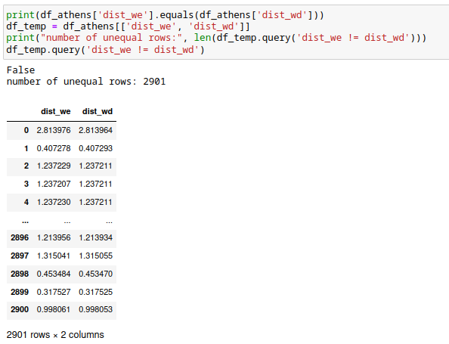
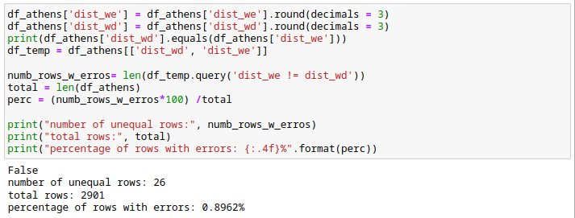
For data of the same city, is it coherent?
Sadly… no.
Columns dist and metro_dist show that for an airbnb with the same latitude and longitude values vary.
Then how do we mitigate this?
Simple… we round it.
(We kept in mind the loss of precision since data was stored in kilometers.)

Slide 8
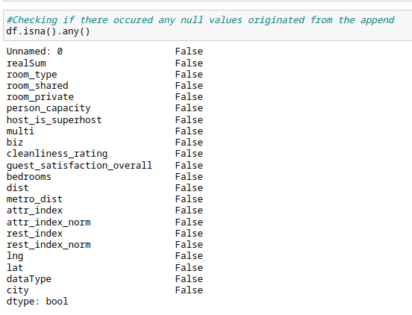
2. Is there missing data in the datasets?
No.
There are no missing values in any of the datasets, so we need not worry ourselves.

Slide 9
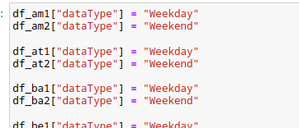
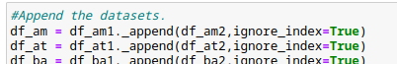
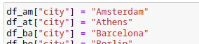
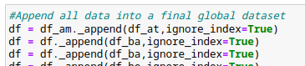
3. How to join the data from all 20 csv files together?
After guaranteeing that all datasets were properly processed, we appended the data into a single dataframe, creating two new columns in the process:
dataType (categorical): informs if the original set where the data came from was a weekend or weekday type
city (categorical): informs the city where the data was collected from

Slide 10
Data visualization
Correlation matrices and graphs

Slide 11
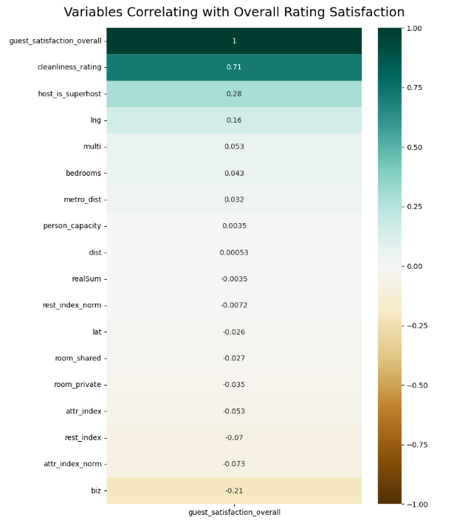
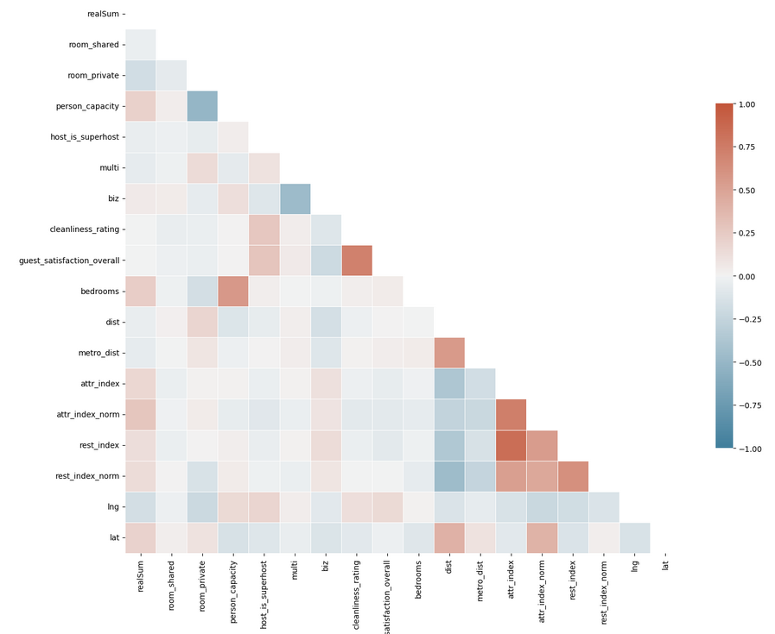
Visualizing Correlation
We started by making a purely visual correlation matrix with the numerical data, to discover the relationship between overall data quickly.

Slide 12
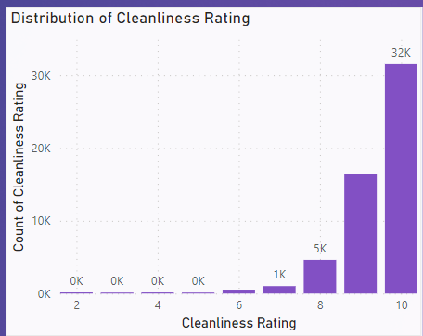
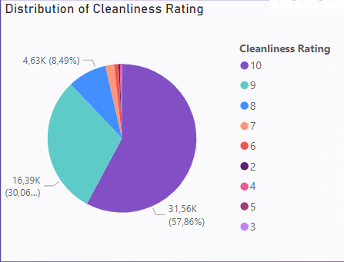

Cleanliness Rating
A clear skew to the right.
More than 50% of the ratings are given 10 in a scale of 0 to 10.
Notes:
We transformed our categorical columns into filters (city filter, day type filter, and room type filter). We analysed the cleanliness rating, the overall rating, the price of the airbnb, indexes (restaurant index and attraction index, and we worked with the normalized column versions), and the distances.

Slide 13
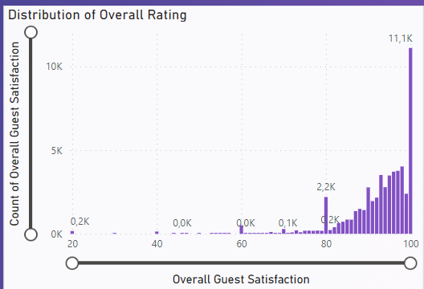
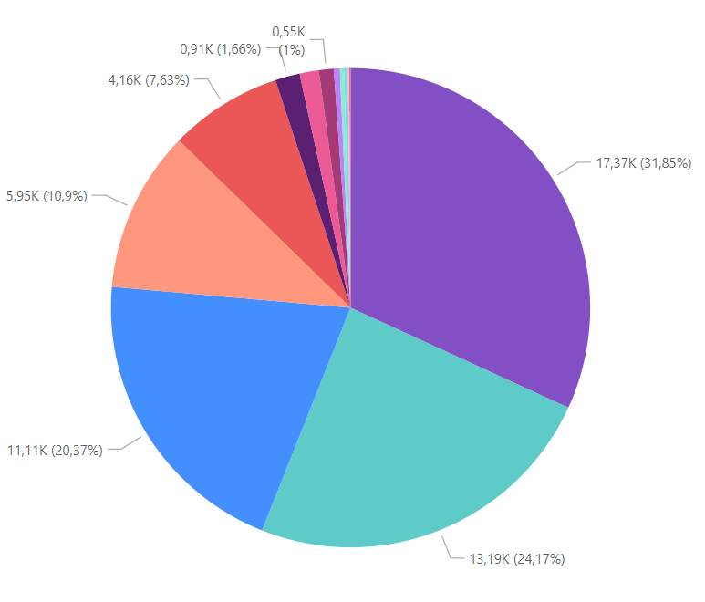
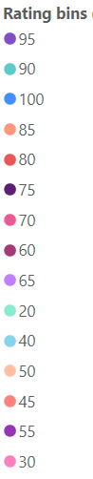
Overall Rating
A clear skew to the higher side of the scale.
In a scale of 0 to 100, more than 50% of the ratings given were between the values 90 and 100.
Notes:
The pie graph has bins of size 5 and the labels show the min value of the bin. AKA: the first label is 95 -> it indicates that it groups all rating votes from rant 95 to 100.

Slide 14
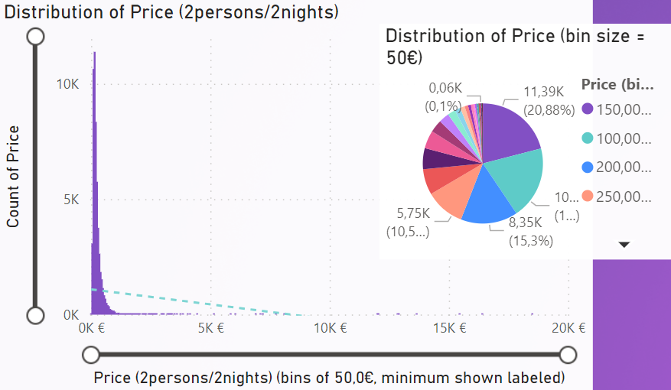
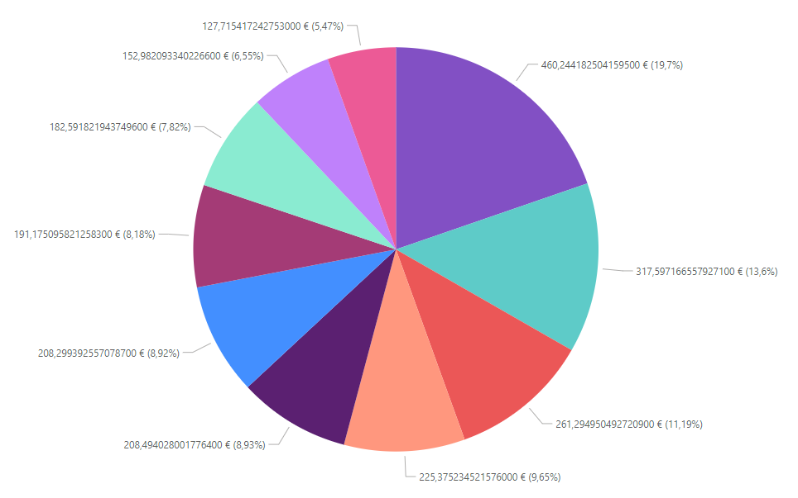
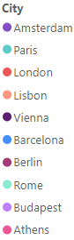
Price of Airbnb
The 50% of the airbnbs have their prices of 2 nights per 2 people between 100€-250€
By median, the three cities with the most expensive Airbnbs are Amsterdam, Paris and London.
Notes:
The small pie graph has bins of size 50€ and the labels show the min value of the bin. AKA: the first label is 150.00€ -> it indicates that it groups all rating votes from rant 150€ to 200€.

Slide 15
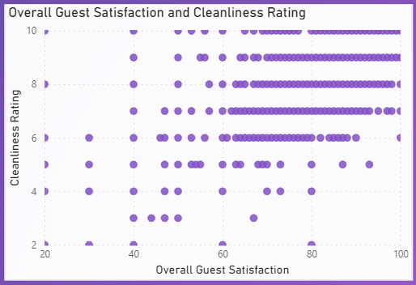
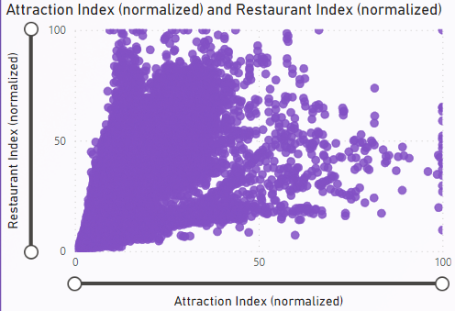
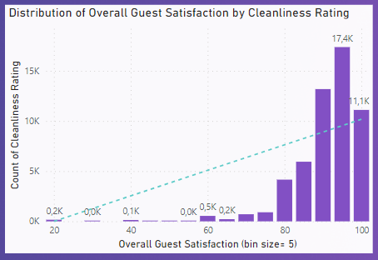
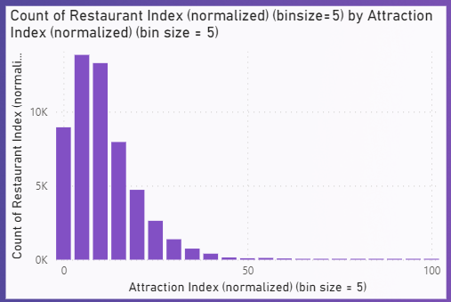
Multivariable analysis - ratings and indexes
Notes:
The small pie graph has bins of size 50€ and the labels show the min value of the bin. AKA: the first label is 150.00€ -> it indicates that it groups all rating votes from rant 150€ to 200€.

Slide 16
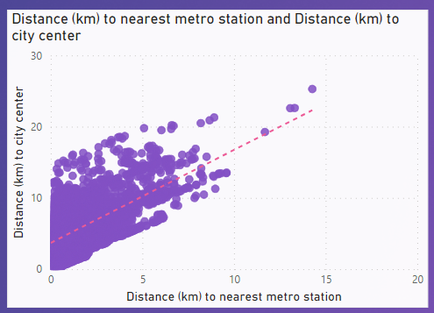
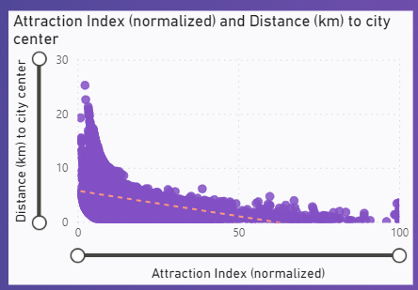
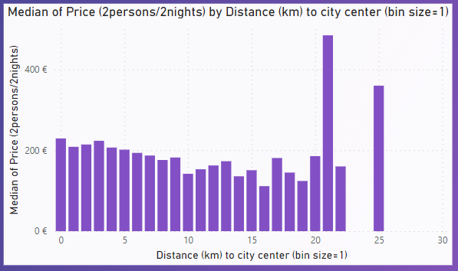
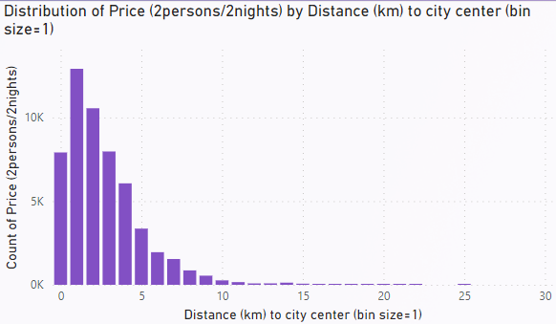
Multivariable analysis - distances
Notes:
The small pie graph has bins of size 50€ and the labels show the min value of the bin. AKA: the first label is 150.00€ -> it indicates that it groups all rating votes from rant 150€ to 200€.

Slide 17
Auto-clustering in PowerBi
Does grouping data offer a more clear view of the situation?

Slide 18
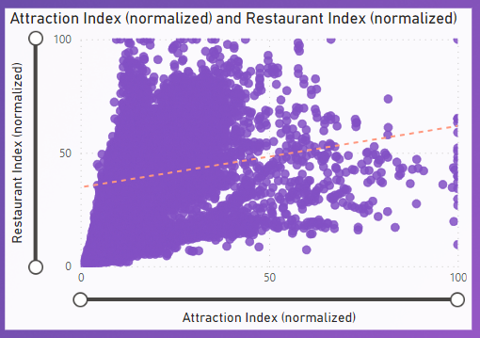
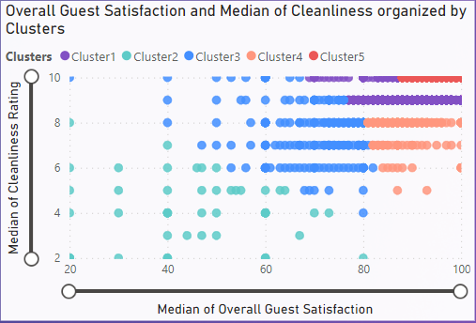
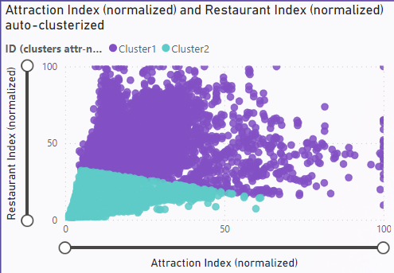
Auto-clustering in PowerBi
Does grouping data offer a more clear view of the situation? No.

Slide 19
So what machine learning model should we apply?

Slide 20
So what machine learning model should we apply?
Depends….
What question are we attempting to answering?

Slide 21
How can we predict the overall guest satisfaction of an airbnb?

Slide 22
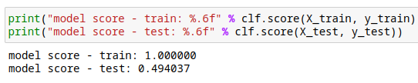
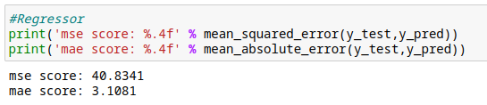
Initial Results
The score of our training group was 100%, while the test group came back with a score of 49,4%. We also verify the MSE and MAE score against the true values of ratings and we respectively had 40.83% and 3.11%.
While these results were not terrible, we wondered if we could improve them…

Slide 23
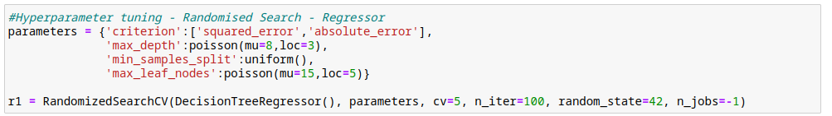
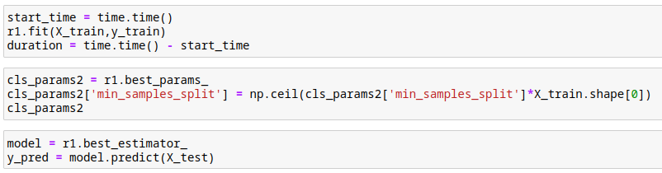
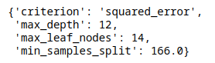
Hyperparameter Tuning
We defined a parameter space and inputted them into an instance of RandomizedSearchCV with a regression tree and fit the model with the training set of X and Y.
When the RandomizedSearchCV finished searching, we retrieved its best parameters, adjusting them a bit by taking the min_samples_split and multiplying it with the number of training samples, taking the ceiling value. The tuned best estimator is then used to predict new Y values.

Slide 24
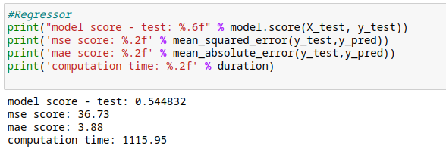
Results with hyperparameter tuning
In terms of score from the test, it increased from 49.4% to 54.47%.
When considering the new predictions of the tuned model, we recalculated the MSE and MAE, which held now values of 36.73% and 3.88%, respectfully. Comparatively, the MSE reduced and the MAE increased. There was an improvement in regression performance and a small decrease in prediction accuracy.

Slide 25
Conclusion

